Slide 1
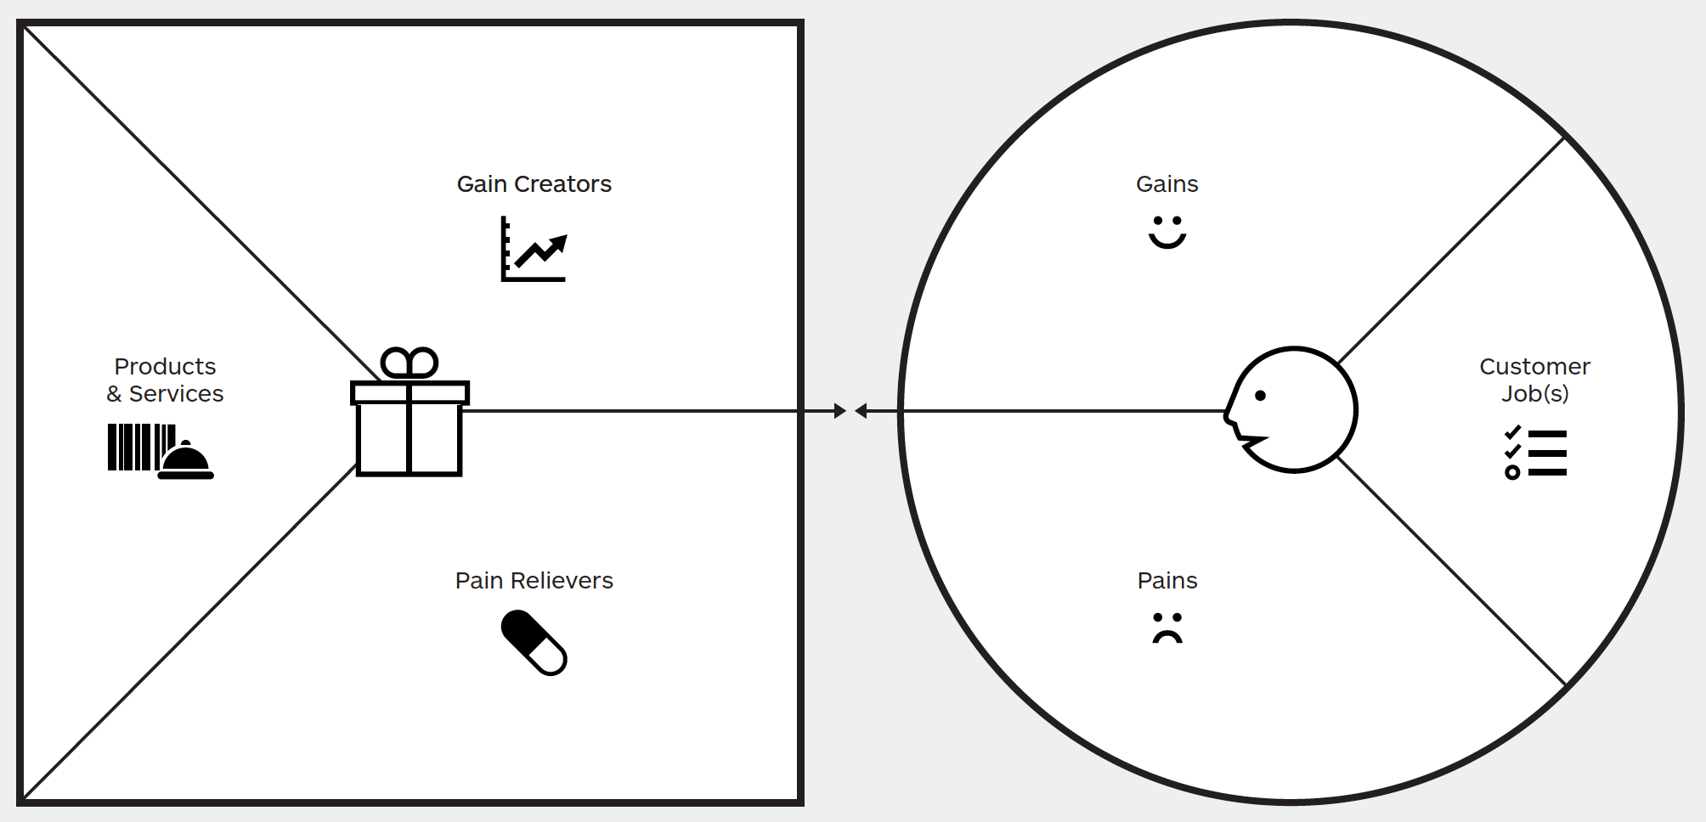
Capturing what is valuable to your Customers
Introducing the Value Proposition Canvas
Value Proposition
Customer Profile
The Value Proposition describes the features of a specific set of services in your business model in a more structured and detailed way. It breaks your value proposition down into products and services and their associated pain relievers, and gain creators.
The Customer Profile describes a specific customer segment in your business model in a more structured and detailed way. It provides a summary of the customer perspective in terms of jobs, pains, and gains.
Gains describe the benefits or outcomes customers want to achieve
Gain Creators describe how your products and services help realise customer gains.
Customer Jobs describe what customers are trying to get done or accomplish in their work and in their lives. Jobs often have functional, emotional and social aspects.
Products and Services is the list of products or services that the proposition is made up of.
Pain Relievers describe how your products and services alleviate customer pains.
Pains describe challenges, bad outcomes, risks, and obstacles customers encounter when fulfilling their jobs.
Customer Fit occurs when your products and services produce pain relievers and gain creators that address one or more of the jobs, pains, and gains that are important to your customer.

Slide 2
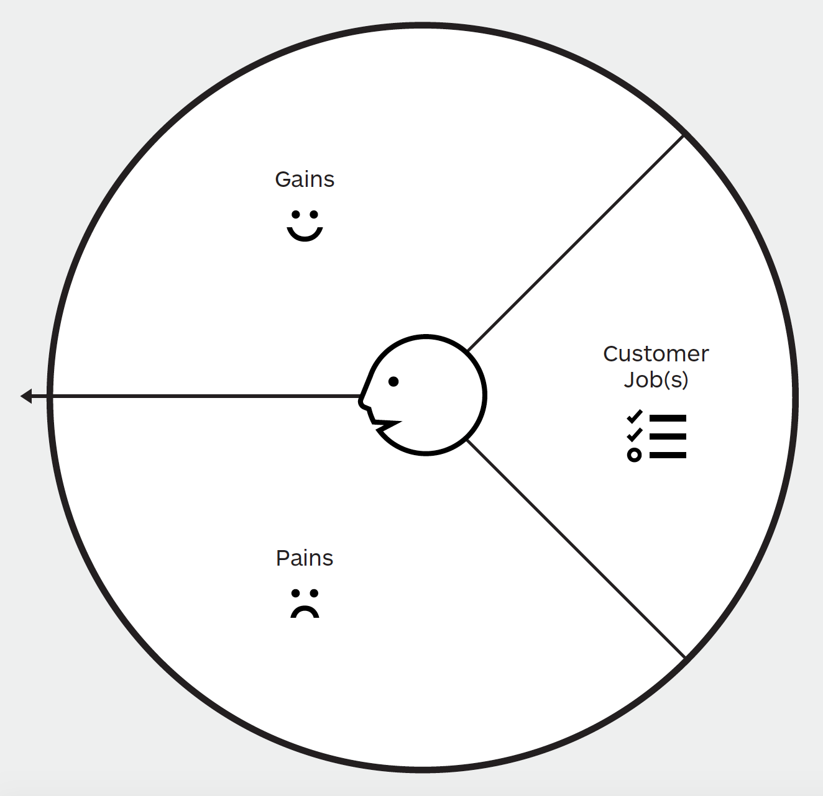
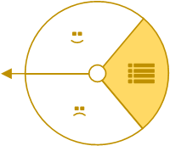


Capturing what is valuable to your Customers
Customer Profile
Customer Jobs describe what customers are trying to get done or accomplish in their work and in their lives. Jobs often have functional, emotional and social aspects.
What are the functional jobs your customers are trying to get done?
What are the emotional jobs your customers looking to get done?
What are the basic needs are your customers trying to satisfy?
Gains describe the benefits or outcomes customers want to achieve.
What would make your customers’ job or life easier?
What outcomes does your customers expect and what go beyond his/her expectations?
How do your current services delight your customers?
How does your customer measure success and failure?
Pains describe challenges, bad outcomes, risks, and obstacles customers encounter when fulfilling their jobs.
How are your current services underperforming for your customers?
What risks do your customers fear?
What barriers are keeping your customer from adopting your services?
What is keeping your customers up at night?

Slide 3
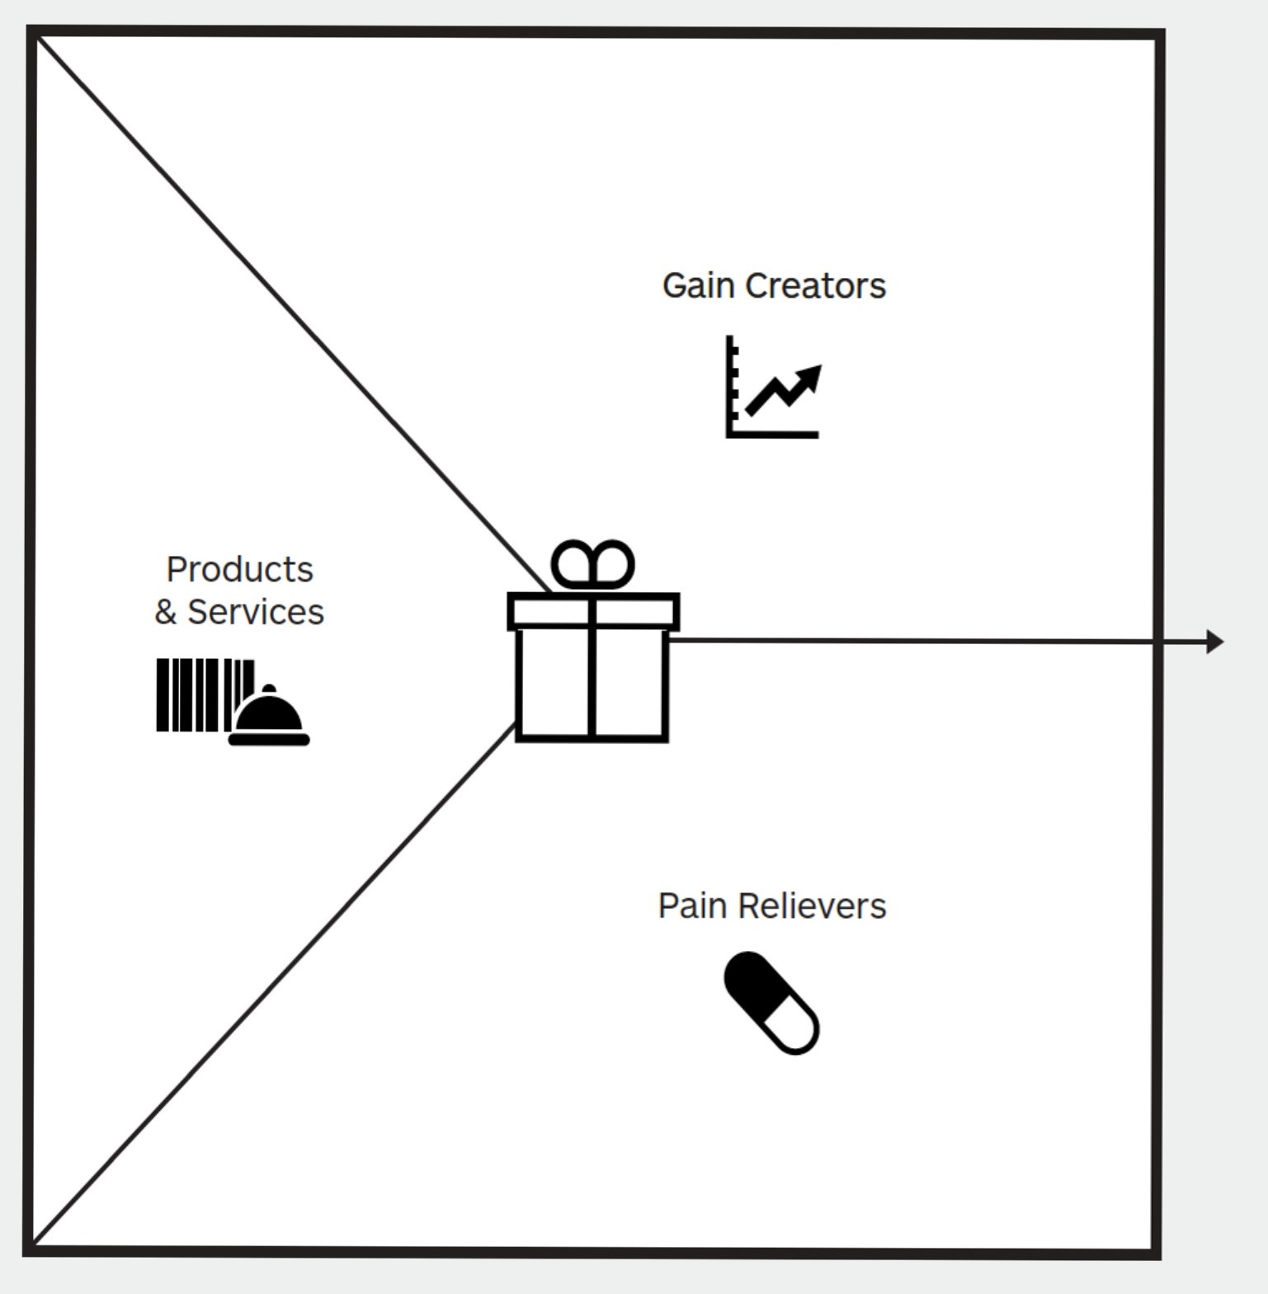
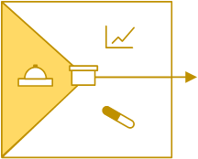
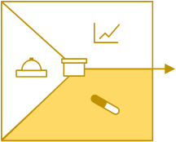
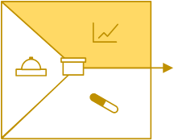
Capturing what is valuable to your Customers
Value Proposition
Products & Services This is the place to list all the features, products and services you’ll provide. You can also list the version of the product you are producing, like freemium, trial. Focus on how the features and products will help customers get their job done.
Pain Relievers focus is on how your product will ease the customers’ pain. These relievers should be relevant to the pains mentioned in the customer profile. Different sort of pain relievers are made for different kinds of pain. However, it isn’t necessary to discuss the whole pain in detail here. Just a simple statement can do the task.
Does your product/ service provide savings? (Regarding time, money, efforts, etc.)
Does it improve the emotional state of your customer? (Decrease grief, irritation, things that bring a headache).
Does it fix the defects of existing solutions?
Does it remove the difficulties or problems that your customer faces?
Does your product/ service exclude the negative social consequences that are encountered or which are afraid of your customers?
Does it reduce the risks that your clients are afraid of?
Does it help your customers sleep better at night?
Does it limit or eradicate common mistakes that customers allow?
Does it eliminate barriers that keep your customers from implementing the specific solution?
Gain Creators show how your product adds value to customers. List everything that offers something new or improves the user experience.
How does your product help customers achieve their goals?
Does your product provide savings that make your client happy?
Does it ensure the results that the customer expects?
Does it simplify the work or life of the customer?
Does it give something that your customer wants to get?
Does your product/ service reflect some of the dreams of your customer?
Does it give positive results that meet the criteria for success and failure of the customer?

Slide 4
Capturing what is valuable to your Customers
Steps to Complete
Choose a customer segment
Identify their jobs and prioritize them according to how important they are to your customer
Identify pains and prioritize them
Identify their gains and prioritize them
Pick the top 3-5 most important pains and gains that relate to the most important jobs
List all the benefits of your product or service
List all pain relievers
List of gain creators
Pick 3-5 of the gain creators and pain relievers, that make the biggest difference to your customer
Link the pain relievers, gain creators and product benefits to the pains, gains and jobs they solve
Define how you’re better than the competition
Create various value propositions that are clear and free of jargon and that builds trust with your customers
Test your value proposition(s) with your customers

Slide 5
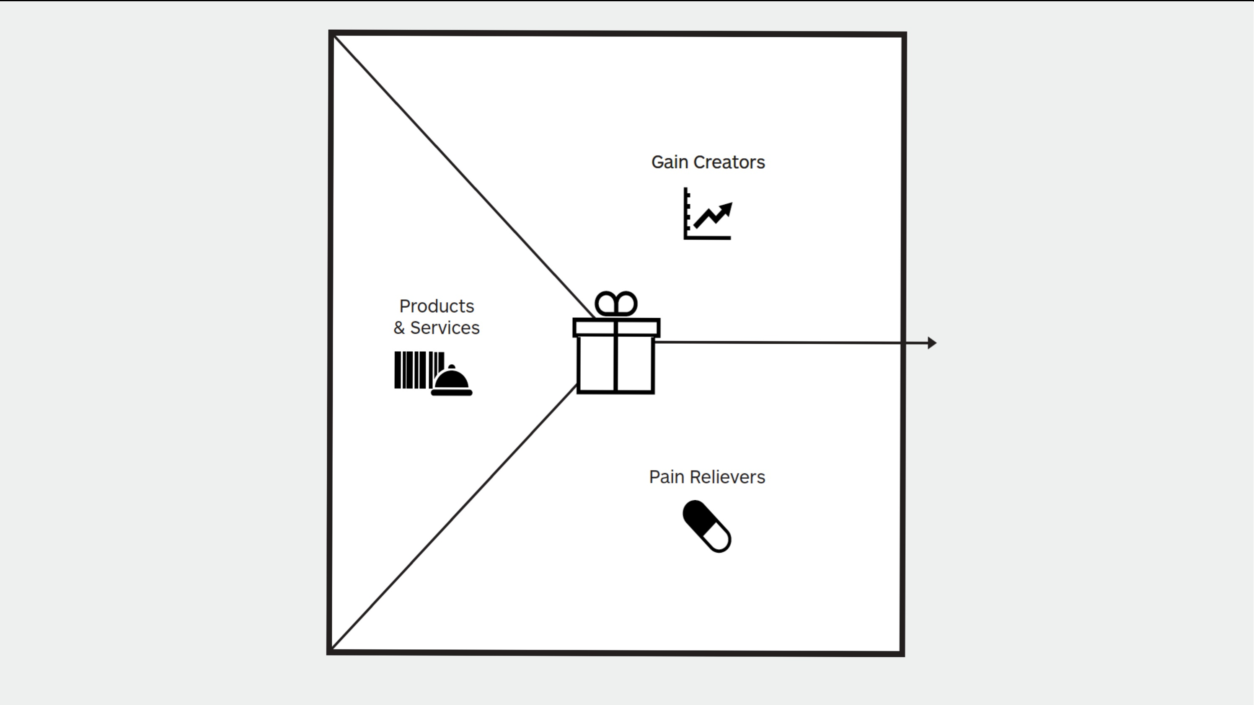
Pallet
Product / Service
Gain Creator
Pain Reliever

Slide 6
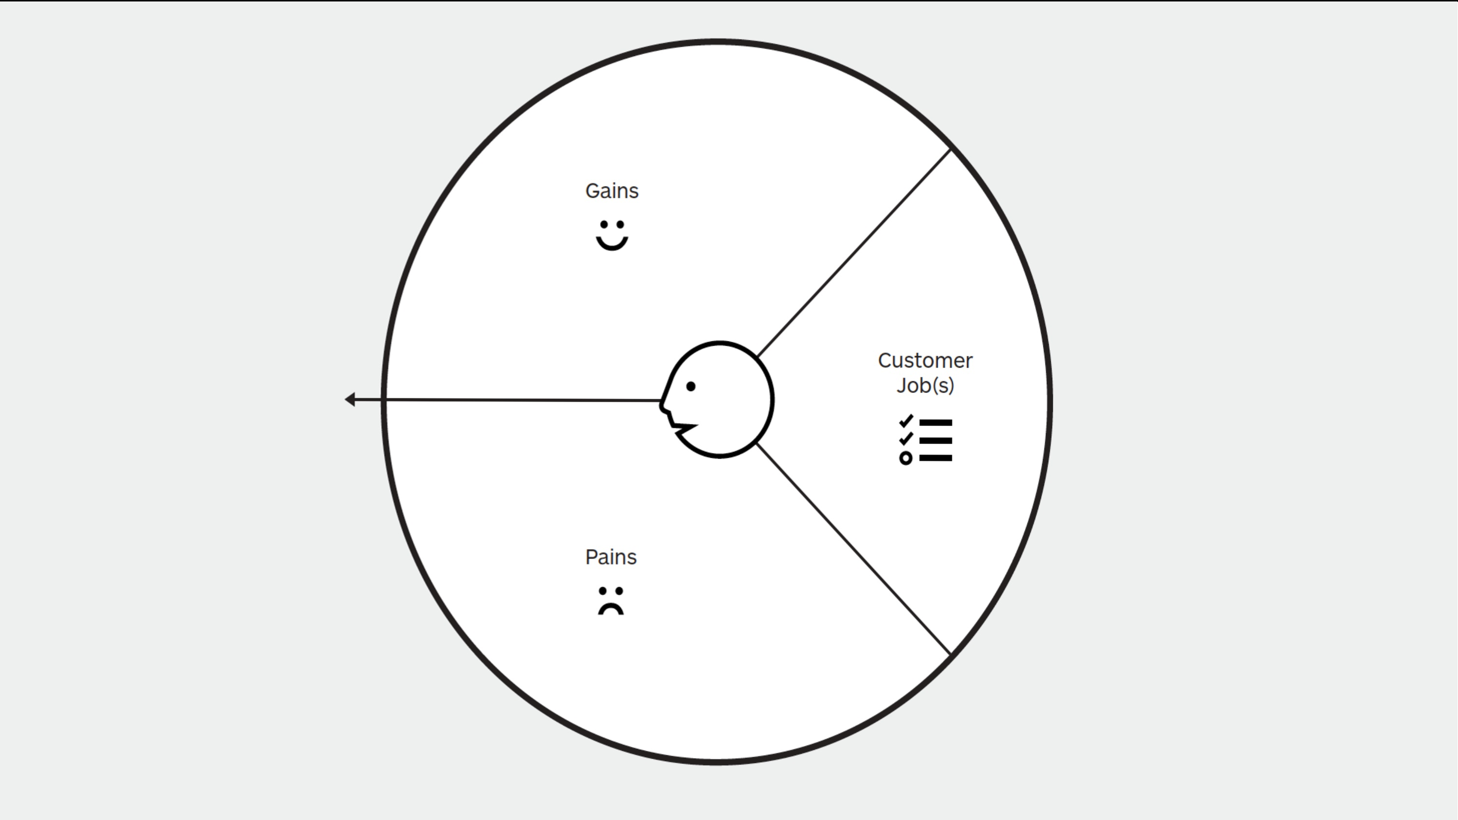
Pallet
Customer Job
Gain
Pain

Slide 7
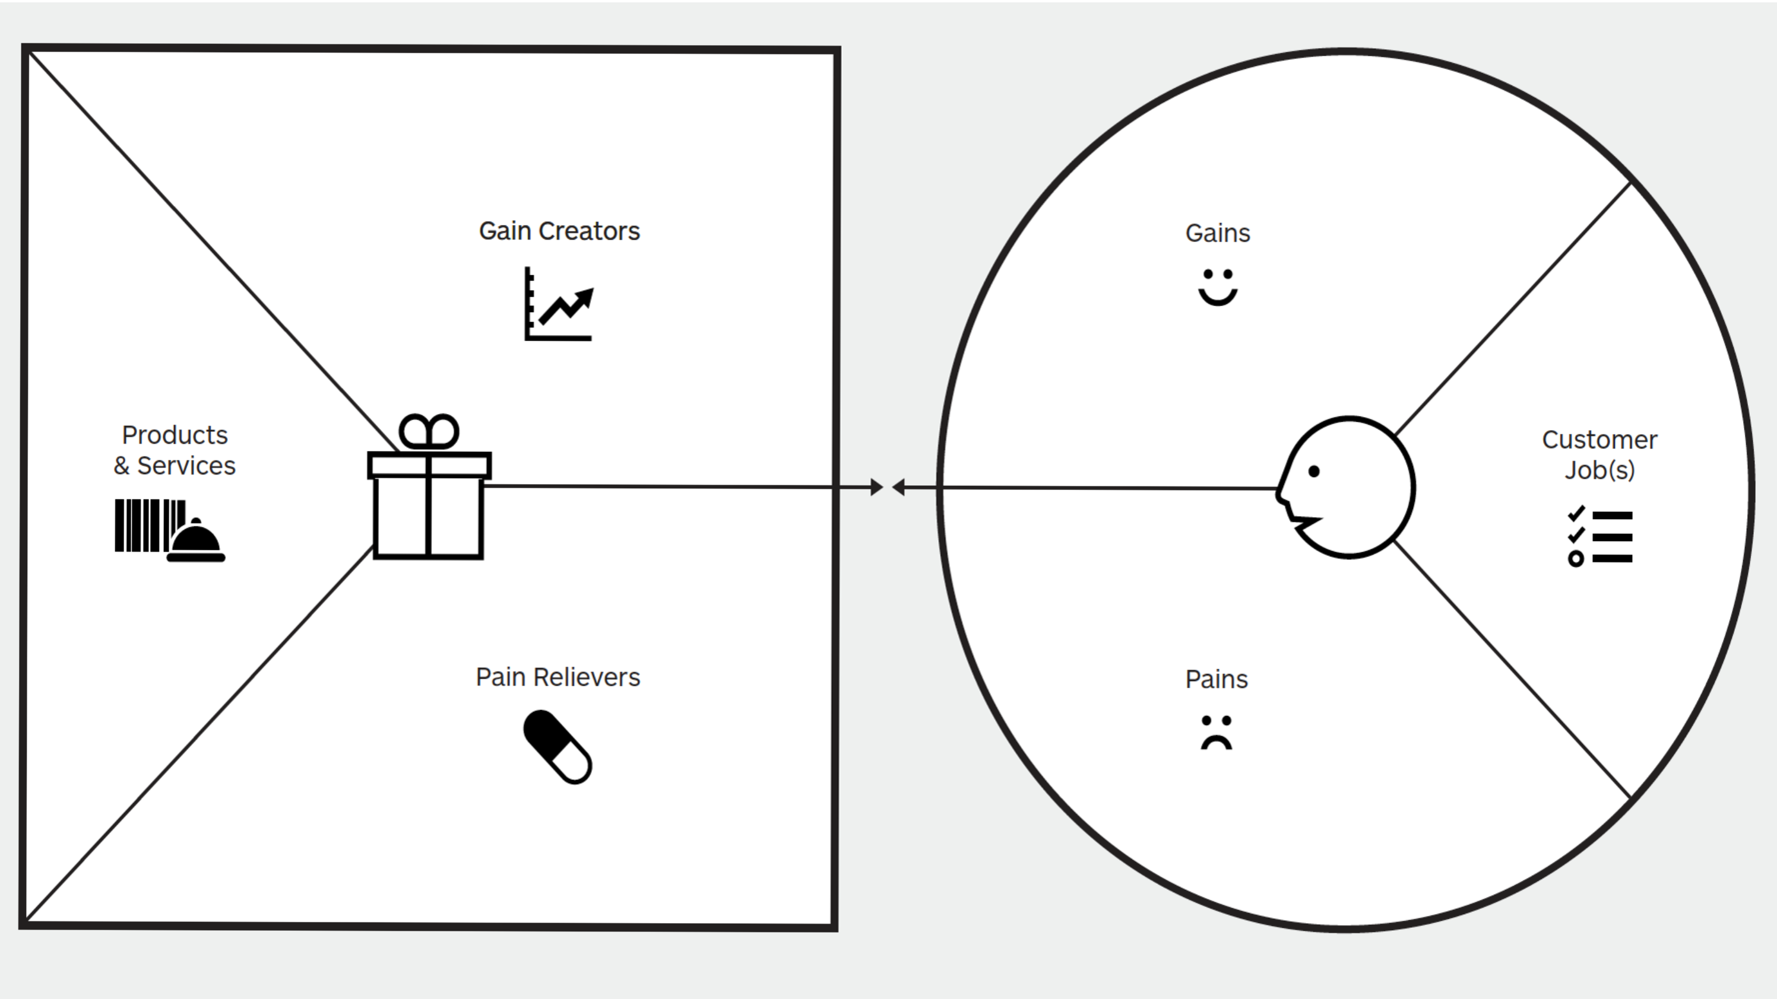
Pallet
Product / Service
Customer Job
Gain Creator
Gain
Pain Reliever
Pain

